Slide 1

DATA SCIENCE TOOLS AND TECHNIQUES
Hadoop Intrusion Detection system using Log Analysis for Network Security
FAST National University of Computer and Emerging Sciences
Kashaf Sajjad (I24-8032)
Muhammad Ahmed Qureshi (24I-8027)
Muhammad Atlas Malik (24I-8020)
Instructor: Dr. Muhammad Ishtiaq

Slide 2
INTRODUCTION
Importance of Intrusion Detection in Network Security
Detects malicious activity in real-time
Identifies threats like malware, DoS attacks & data breaches
Monitors traffic & logs for anomalies
Enables early threat detection & fast response
Helps in post-attack forensic analysis
Challenges of Analyzing Large-Scale Log Data
Massive log volume (TBs to PBs)
Logs exist in varied formats
Sensitive data requires secure handling
Irrelevant data increases complexity
Traditional tools lack scalability
Role of Distributed Computing in CyberSecurity
Hadoop stores massive logs
Spark processes in-memory for speed
Real-time threat detection
Reduces costs using commodity hardware
Supports live log ingestion with Apache Flume
MLlib helps train models for anomaly detection

Slide 3


Project Objective
Efficient log collection
Scalable storage & processing
Machine learning-based anomaly detection
Showcase the power of Hadoop and Spark for big data security analytics

Slide 4
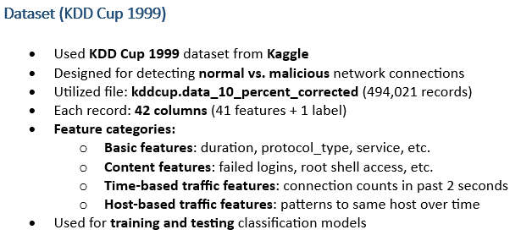
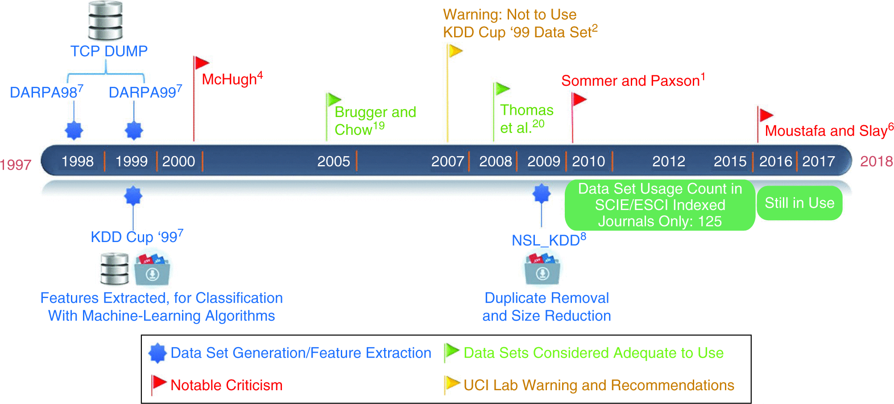
Dataset Overview

Slide 5


Slide 6
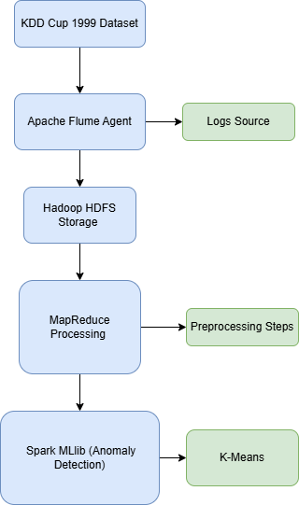
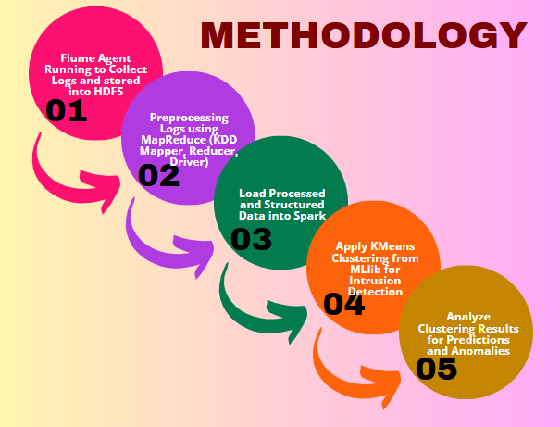
System Architecture

Slide 7



Tools & Technologies
Apache Flume for Data ingestion
Hadoop HDFS for Distributed storage
MapReduce for Log pre-processing
Apache Spark MLlib for ML algorithms

Slide 8
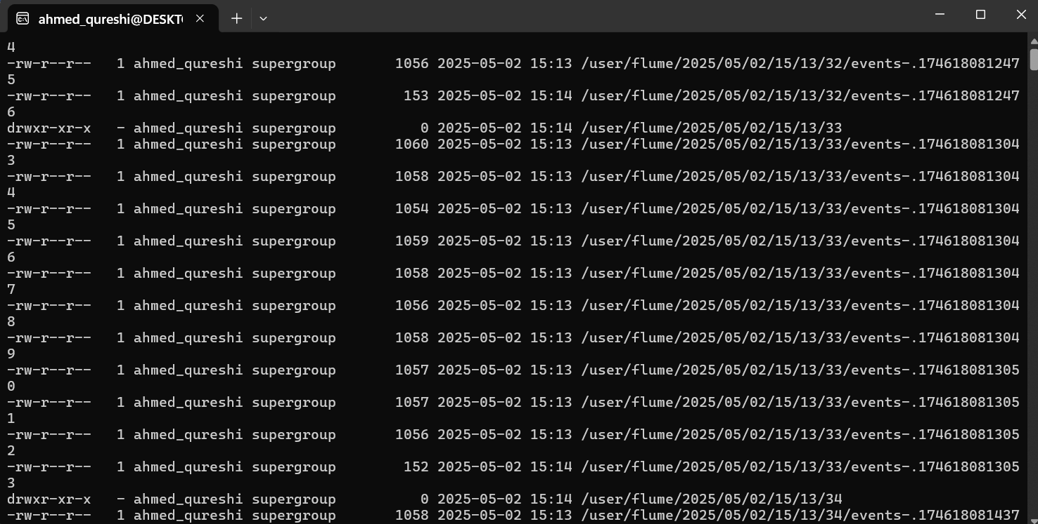
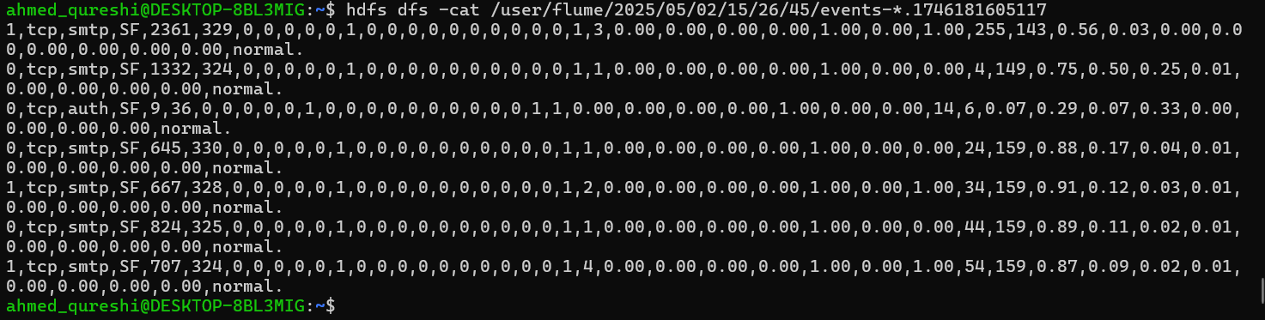
Data Collection Using Flume
How Flume collects streaming logs or dataset files
KDD Cup 1999 dataset
Configurations used (source, sink, channel)
The sink was set to HDFS for direct log storage
Hadoop installed for data storage.
Ensured Flume writes logs into HDFS for MapReduce preprocessing

Slide 9
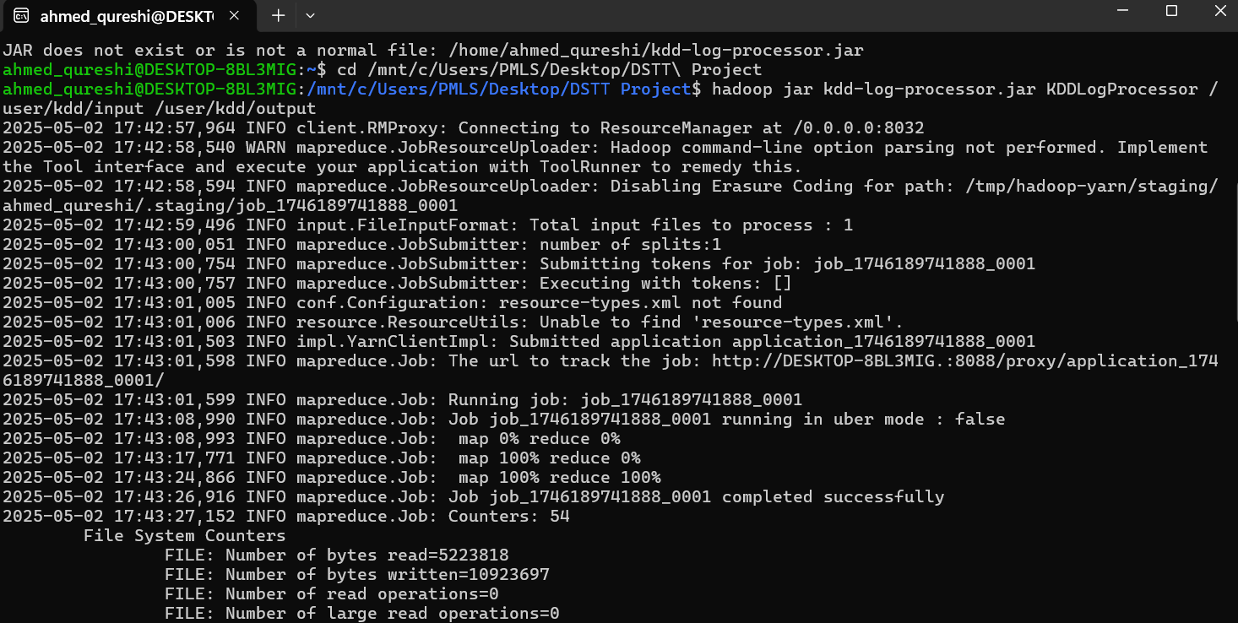
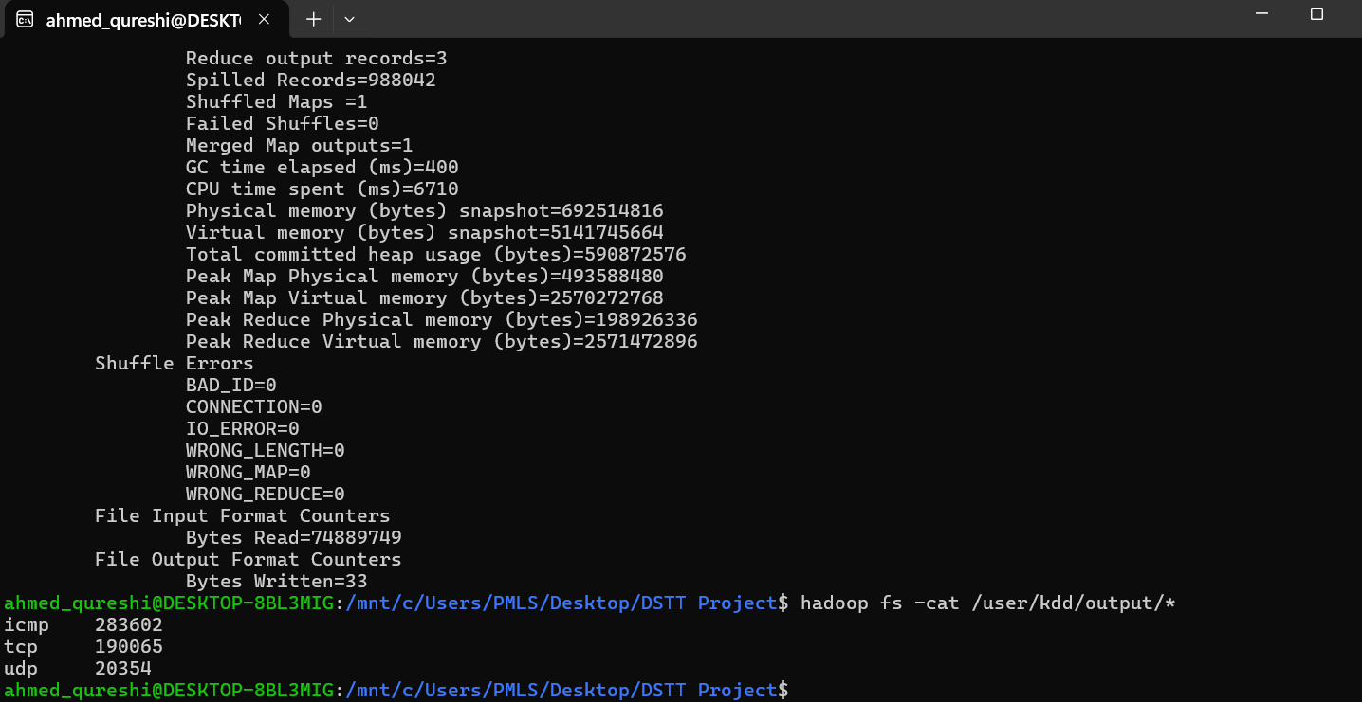
Preprocessing with MapReduce
Used MapReduce framework with Mapper and Reducer components
Mapper: Extracted protocol type (TCP, UDP, ICMP) from each log entry
Emitted key-value pairs: protocol → 1
Reducer: Aggregated counts of each protocol type
Output: Total occurrences of each protocol in the dataset
Implemented in Java using KDDPreprocessMapper (for mapping), KDDPreprocessReducer (for reducing) and KDDLogProcessor (driver to configure and run the job)

Slide 10
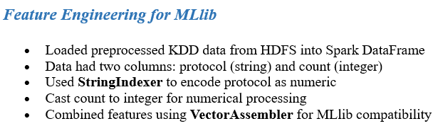
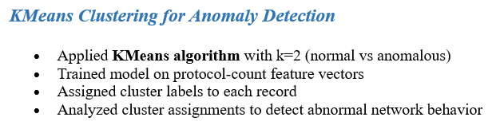
Anomaly Detection with Spark MLlib

Slide 11
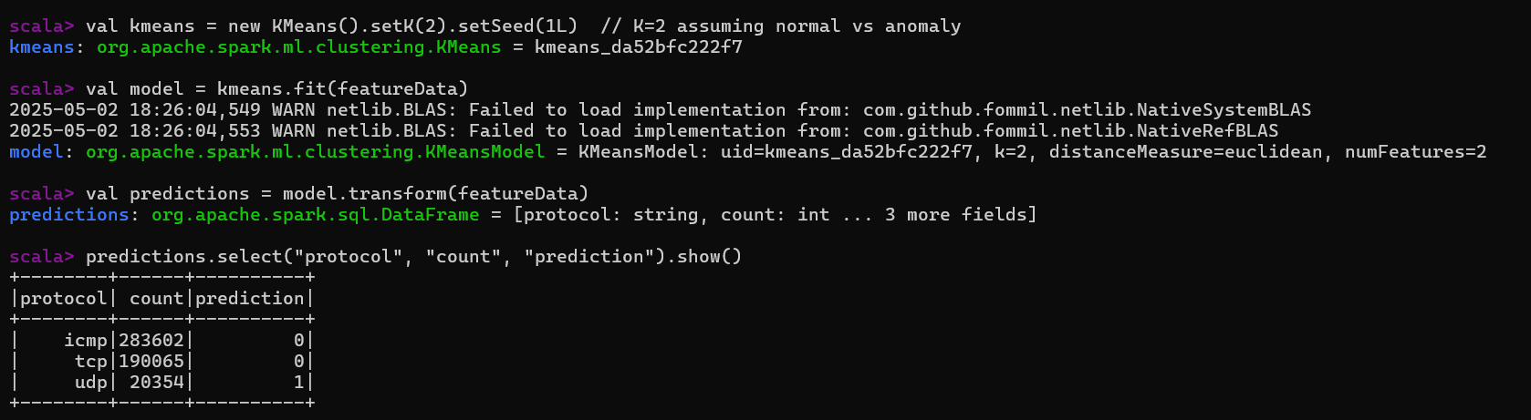
Final Output

Slide 12
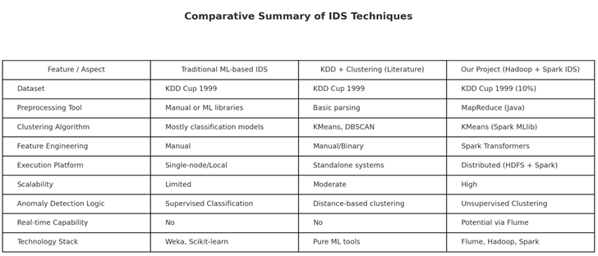
COMPARITIVE ANALYSIS

Slide 13

Challenges & Solutions
Large data volume handling
Log format inconsistencies
Model accuracy tuning

Slide 14

Developed a scalable, end-to-end Intrusion Detection System (IDS) using the Hadoop ecosystem.
Efficient log collection using Apache Flume from static and streaming sources.
Distributed storage of network logs in HDFS, enabling fault-tolerant and parallel processing.
Preprocessing and feature extraction using MapReduce to structure the dataset for ML.
Anomaly detection using Spark MLlib with models such as k-Means and SVM.

Slide 15





Work Distribution
Project Report
Prepared by Kashaf Sajjad
Slides Preparation
Apache Flume Agent Setup
Prepared by Atlas Malik
Implemented by Ahmed Qureshi
Model Training using Mlib
Logs Storage into HDFS
Implemented by Muhammad Atlas Malik
Implemented By Ahmed Qureshi
MapReduce Implementation
Implemented by Kashaf Sajjad

Slide 16


